Slide 1
Unit 10 Live Session
Model Identification for Non Stationary Data

Slide 2
Final Exam Announcements
Final Exam in Cumulative
There will be an in-class portion. This will be similar to all the problems on the midterm except for the last one. This will be on the last day of class.
There will also be a take home portion that you will get at the end of the in-class portion and will be due on that Saturday.

Slide 3
Project
The project will be a group project with groups no larger than 2 people (you may do the project on your own if you like.)
You will be able to select your own data.
Specifics of the project will be available next week.

Slide 4
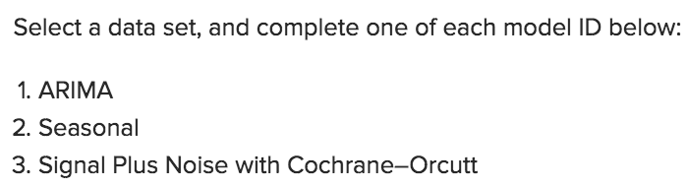
Break Out 1
There may be several different approaches to how the first part of For Live Session was interpreted. Simply describe what you did for these questions:
Some students generated data, some used a dataset and analyzed it with all three, some did an alternative analysis. As I looked through them, all the ones I saw before live session were very creative and very useful. Simply discuss your thoughts and explain your analysis!

Slide 5
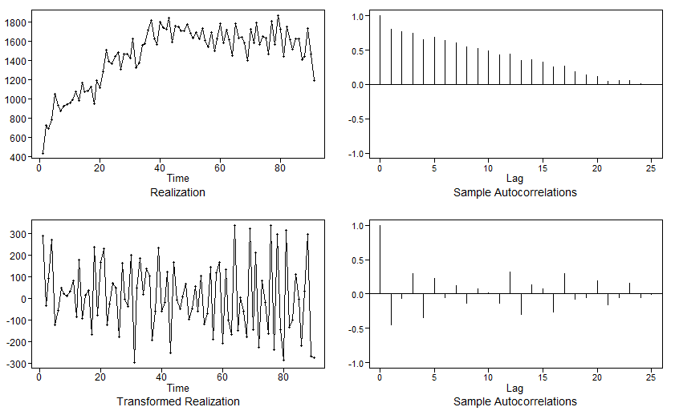
Question 1: Complete an ARIMA model
For this problem, I will revisit the FQHC ‘no-show’ problem, a ‘side-project’ from the Capstone B project. We see the original data set, through inspection of the ACF, a pattern typically associated with ARIMA models. As such, we take the first difference and then plot again. If the data appears stationary, we can proceed with modeling.
We see a few other things that we should also take note of: 1.) the original data set does not appear to be white noise. 2.) Taking the first difference leads to what appears to be stationary data.

Slide 6
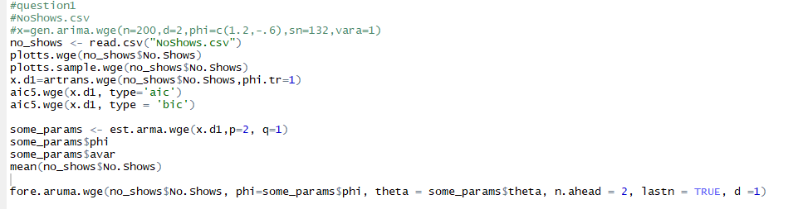

Slide 7
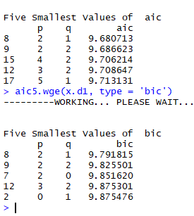
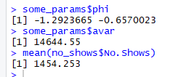
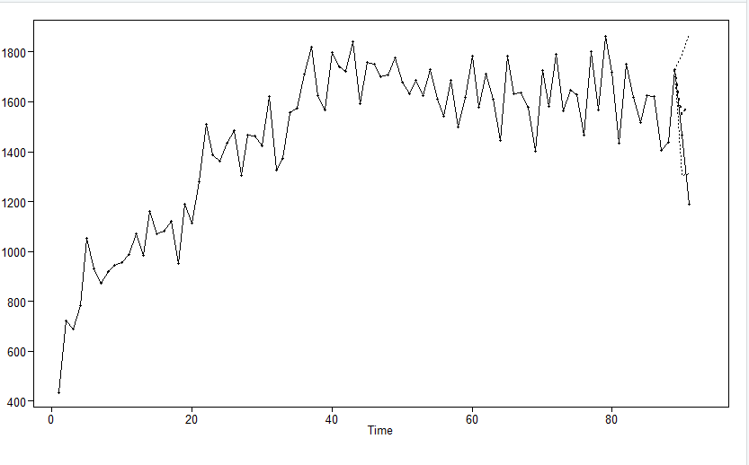
ARIMA: continued
Now that we have a stationary data set, we can estimate using the AIC and BIC. Both of these methods converge to the same solution: (2, 1).
We now have some evidence of the appropriate correlation structure. Next, we can estimate phi and theta using the same workflow we learned in unit 9.
We capture the terms in the following command:
Finally, we are able to forecast combining all the topics from unit 7, 9, and 10. I forecast two periods ahead using fore.aruma:
The forecast vs. actual values look to
be acceptable and within the limits.
Recall this data set is monthly so a
forecast horizon of 2 is reasonable.

Slide 8
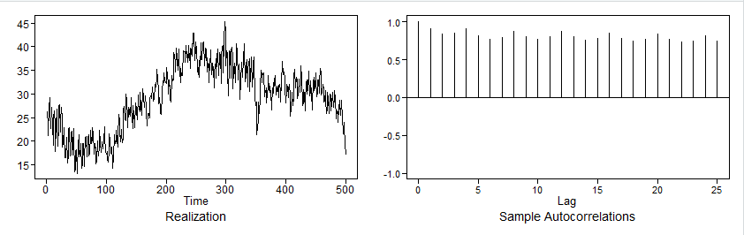
Question 2: Complete a Seasonal model
For this seasonal model, I simulate a quarterly data set where n=500 (see code appendix for full code).
The data set reveals, through the ACF, strong peaks at approximately every 4th lag. We should never assume there is a seasonal component without inspecting the factor tables.
Next, we’ll follow the ‘overfit’ table approach and see if the factors cancel.

Slide 9
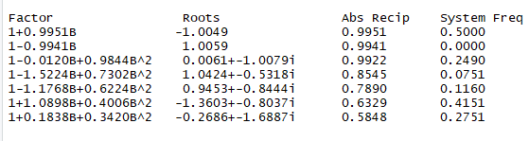
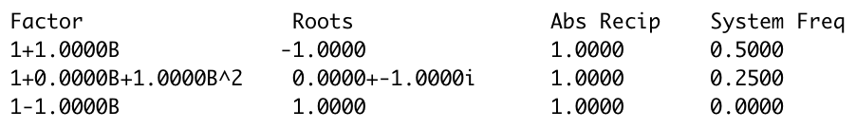
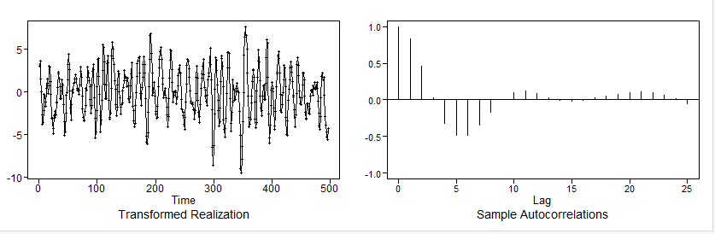
We obtain the factor table as follows for the data set:
The following factors match:
Root 1 with system freq of 0
Root -1 with system freq of 0.5
Root 0+- -1i with system freq of .25.
Recall from a factor table of (1-b^4), these are the three factors needed to match to conclude there is a quarterly component. It is not recommended we stop there. As we inspect the rest of the factor table, there are no other match factors.
An overfit factor table of where B^4
It is now obvious that there is a seasonal component of 4. We can now transform the data using ar.trans where we specify (1-B^4) (see code appendix).
The transformed data looks
Stationary and ready for modeling.

Slide 10
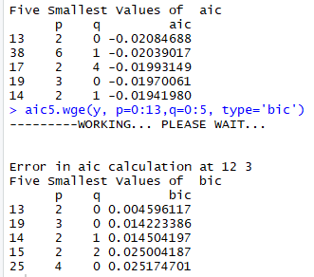
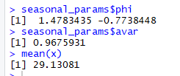
The next step is to use AIC5, inspecting AIC and BIC for the most appropriate model:
Both AIC and BIC converge to the same solution: (2,0)
Since this was a simulated data set, we see the phi terms are very close to those specified in the data creation. Also, when we either write this formula out or forecast, the s=4 term is needed because through an inspection of the factor tables, we know there is an s=4 component for this realization.

Slide 11
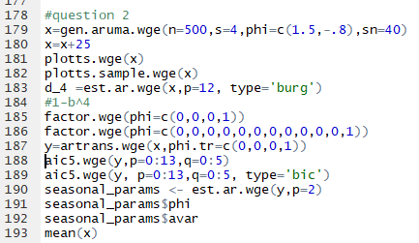

Slide 12
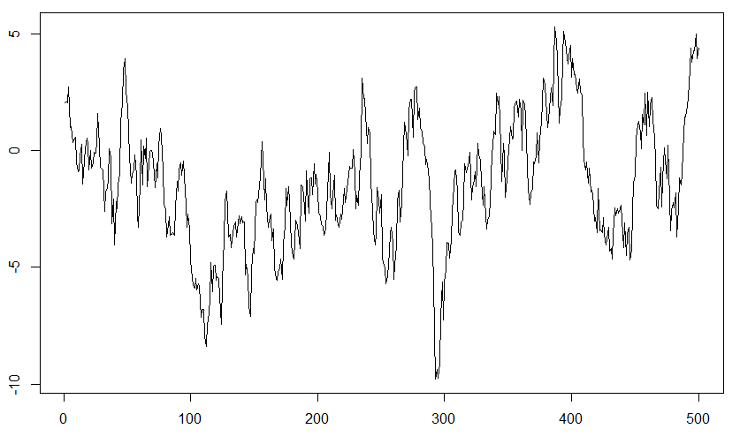


Question 3: Complete a Signal + Noise model w/Cochrane-Orcutt
*To test Cochrane-Orcutt, I create a realization that has zero slope and a high phi. The phi is equal to .95. The raw data looks like this: (n=500)
The OLS fit reveals a low p-value. This is a dangerous assumption because it could lead one to make errors in forecasting (an understanding the data). The OLS fit is on the left and the Cochrane-Orcutt is on the right. In this case, we should fail to reject the null hypothesis per the Cochrane-Orcutt test. This is correct because we know the data was generated from a signal plus noise function in R.

Slide 13
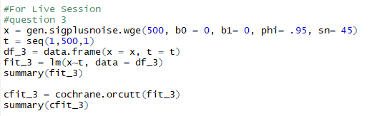

Slide 14
PDF of Nile river bank data.

Slide 15
Break Out 2

Slide 16
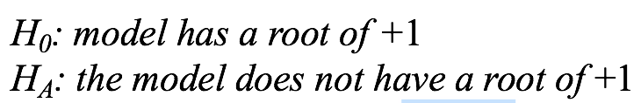
Question 1
What is the Ho and Ha of the Dickey-Fuller Test? Do this from memory if you can.

Slide 17
Question 2
Consider the Dicky Fuller Test. If we conclude that there is no evidence of a unit root when a unit root is present in the model, what type of error have we made?
Type I
Type II
Type III

Slide 18
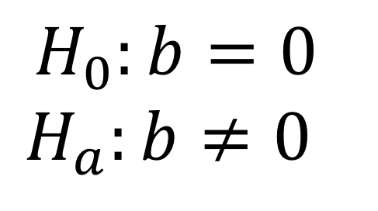
Question 3
What is the Ho and Ha of the Cochrane Orcutt Test? Do this from memory if you can.
$$H_{0}:b=0$$
$$H_{a}:b≠0$$

Slide 19
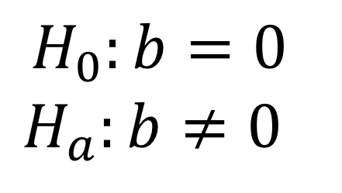
Question 4
Consider the Cochrane Orcutt Test. If we conclude that there is not enough evidence to suggest non zero slope (when the slope is actually not 0), what kind of error have we made?
Type I
Type II
Type III
$$H_{0}:b=0$$
$$H_{a}:b≠0$$

Slide 20
Break Out 3

Slide 21

Forecasting Using Signal Plus Noise and the Cosine (patemp data)
Use the help function (?fore.signalplusnoise.wge) to help you figure out how to fit a signal plus noise model to the Pennsylvania temperature data (patemp).
Write the specification of the model with the estimated white noise variance.
Hint:
bo = interecept, A1 = xmtx1, A2 = xmtx2 from attribute b.
In addition, find the ASE associated with the best model you can fit to the data. (n.ahead = 24)
Compare this with the ASE from the fit of a model with a (1-B^12) in the model (n.ahead = 24)
Why is the (1-B^12) model not recommended for this data?

Slide 22
Code For patemp analysis and comparison.
#Signal Plus Noise with sinusoidal trend.
parzen.wge(patemp) # Get an idea of the frequency from here and your knowledge about temperatures.
fore.patemp.spn = fore.sigplusnoise.wge(patemp,freq = .083, max.p = 4, n.ahead = 24, linear = FALSE, lastn = TRUE)
ASE.spn = mean((patemp[(length(patemp)-23): length(patemp)]-fore.patemp.spn$f)^2)
ASE.spn
#(1-B^12)Xt = at … note that the factor table does not support this model… but I will argue that it is still useful.
fore.patemp.B12 = fore.aruma.wge(patemp,s = 12, n.ahead = 24, lastn = TRUE)
ASE.B12 = mean((patemp[(length(patemp)-23): length(patemp)]-fore.patemp.B12$f)^2)
ASE.B12
#AR(2)(1-B^12)Xt= at … note that the factor table does not support this model… but I will argue that it is still useful.
patemp_B12 = artrans.wge(patemp, phi.tr = c(rep(0,11),1))
aic5.wge(patemp_B12)
patemp.est.B12.AR2 = est.arma.wge(patemp_B12,p = 2)
fore.patemp.B12.AR2 = fore.aruma.wge(patemp,s = 12, phi = patemp.est.B12.AR2$phi, n.ahead = 24, lastn = TRUE)
ASE.B12.AR2 = mean((patemp[(length(patemp)-23): length(patemp)]-fore.patemp.B12.AR2$f)^2)
ASE.B12.AR2
#This one has unit root but is not of the form (1-B)^d or (1-B^s)… it is of the form (1 – lamda1B + B^2)
y.tr=artrans.wge(patemp,phi.tr=c(1.732,-1))
patemp.est.lamda.AR3 = est.ar.wge(y.tr,p=3)
fore.patemp.L2.AR3 = fore.aruma.wge(patemp,lambda = c(1.732, -1), phi = patemp.est.lamda.AR3$phi, n.ahead = 24, lastn = TRUE)
ASE.L2.AR3 = mean((patemp[(length(patemp)-23): length(patemp)]-fore.patemp.L2.AR3$f)^2)
ASE.L2.AR3

Slide 23
Forecasting Using Signal Plus Noise and the Cosine (patemp data)
Use the help function (?fore.signalplusnoise.wge) to help you figure out how to fit a signal plus noise model to the Pennsylvania temperature data (patemp).
Write the specification of the model with the estimated white noise variance.
In addition, find the ASE associated with the best model you can fit to the data.
Compare this with the ASE from the fit of a model with a (1-B^12) in the model
Why is the (1-B^12) model not recommended for this data?

Slide 24
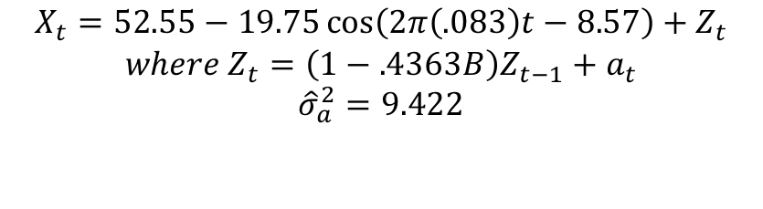
Forecasting Using Signal Plus Noise and the Cosine (patemp data)
Use the help function (?fore.signalplusnoise.wge) to help you figure out how to fit a signal plus noise model to the Pennsylvania temperature data (patemp).
Write the specification of the model with the estimated white noise variance.
$$X_{t}=52.55−19.75\cos\left(2π\left(.083\right)t−8.57\right)+Z_{t}$$
$$where Z_{t}=\left(1−.4363B\right)Z_{t−1}+a_{t}$$
$${\hat{σ}}_{a}^{2}=9.422$$

Slide 25

Forecasting Using Signal Plus Noise and the Cosine (patemp data)
Use the help function (?fore.signalplusnoise.wge) to help you figure out how to fit a signal plus noise model to the Pennsylvania temperature data (patemp).
Write the specification of the model with the estimated white noise variance.
In addition, find the ASE associated with the best model you can fit to the data.

Slide 26


Forecasting Using Signal Plus Noise and the Cosine (patemp data)
Use the help function (?fore.signalplusnoise.wge) to help you figure out how to fit a signal plus noise model to the Pennsylvania temperature data (patemp).
Write the specification of the model with the estimated white noise variance.
In addition, find the ASE associated with the best model you can fit to the data.
Compare this with the ASE from the fit of a model with a (1-B^12) in the model

Slide 27
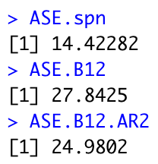
Forecasting Using Signal Plus Noise and the Cosine (patemp data)
Use the help function (?fore.signalplusnoise.wge) to help you figure out how to fit a signal plus noise model to the Pennsylvania temperature data (patemp).
Write the specification of the model with the estimated white noise variance.
In addition, find the ASE associated with the best model you can fit to the data.
Compare this with the ASE from the fit of a model with a (1-B^12) in the model

Slide 28
Forecasting Using Signal Plus Noise and the Cosine (patemp data)
Use the help function (?fore.signalplusnoise.wge) to help you figure out how to fit a signal plus noise model to the Pennsylvania temperature data (patemp).
Write the specification of the model with the estimated white noise variance.
In addition, find the ASE associated with the best model you can fit to the data.
Compare this with the ASE from the fit of a model with a (1-B^12) in the model
Why is the (1-B^12) model not recommended for this data?
Factor tables and thus the spectral densities don’t resemble one another…. nevertheless, it may be the most useful model.

